Slide 1

Diseño de base de datos
Profesor Ing. Javier Pereira

Slide 2

NULL en condición

Slide 3
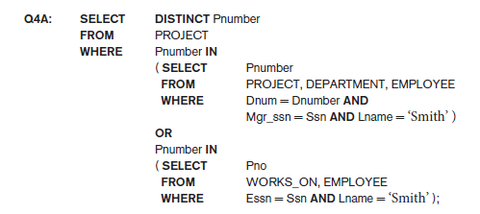
Consultas anidadas

Slide 4

IN por tuplas

Slide 5

ALL

Slide 6
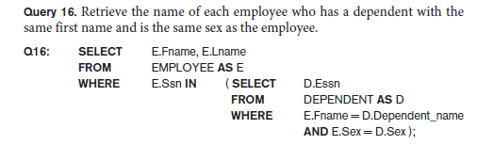
Join con consulta anidada

Slide 7
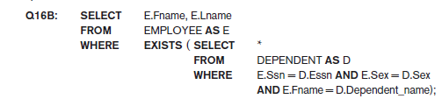
EXISTS

Slide 8
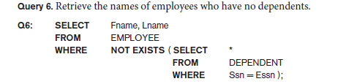
NOT EXISTS

Slide 9
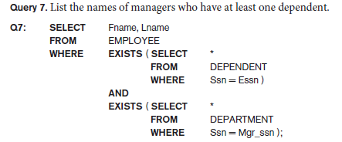
EXISTS

Slide 10
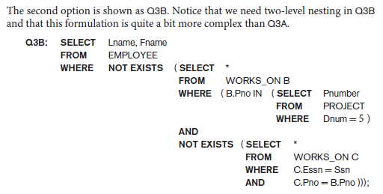
NOT EXISTS – IN anidados

Slide 11
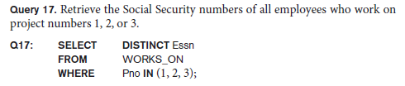
IN explícito

Slide 12

JOIN/INNER JOIN

Slide 13

LEFT JOIN

Slide 14

MULTIPLE JOIN

Slide 15


AGREGACIONES

Slide 16
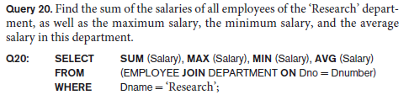
AGREGACIONES con JOIN

Slide 17
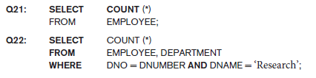
COUNT

Slide 18

COUNT DISTINCT

Slide 19
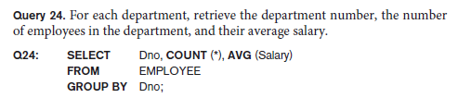
GROUP BY y HAVING

Slide 20
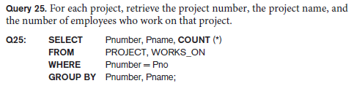
GROUP BY

Slide 21
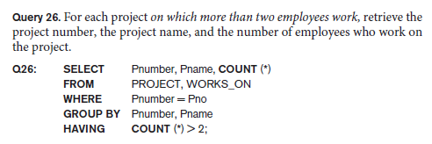
HAVING

Slide 22
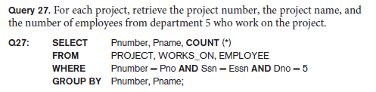
GROUP BY - JOIN

Slide 23

HAVING

Slide 24

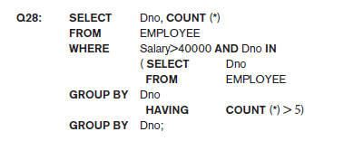
HAVING – INNER QUERY

Slide 25
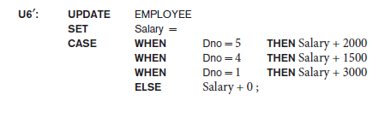
CASE (no estándar)

Slide 26
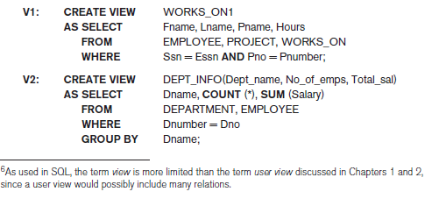
VISTAS

Slide 27
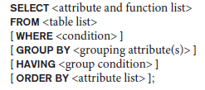
RESUMEN

